Slide 1
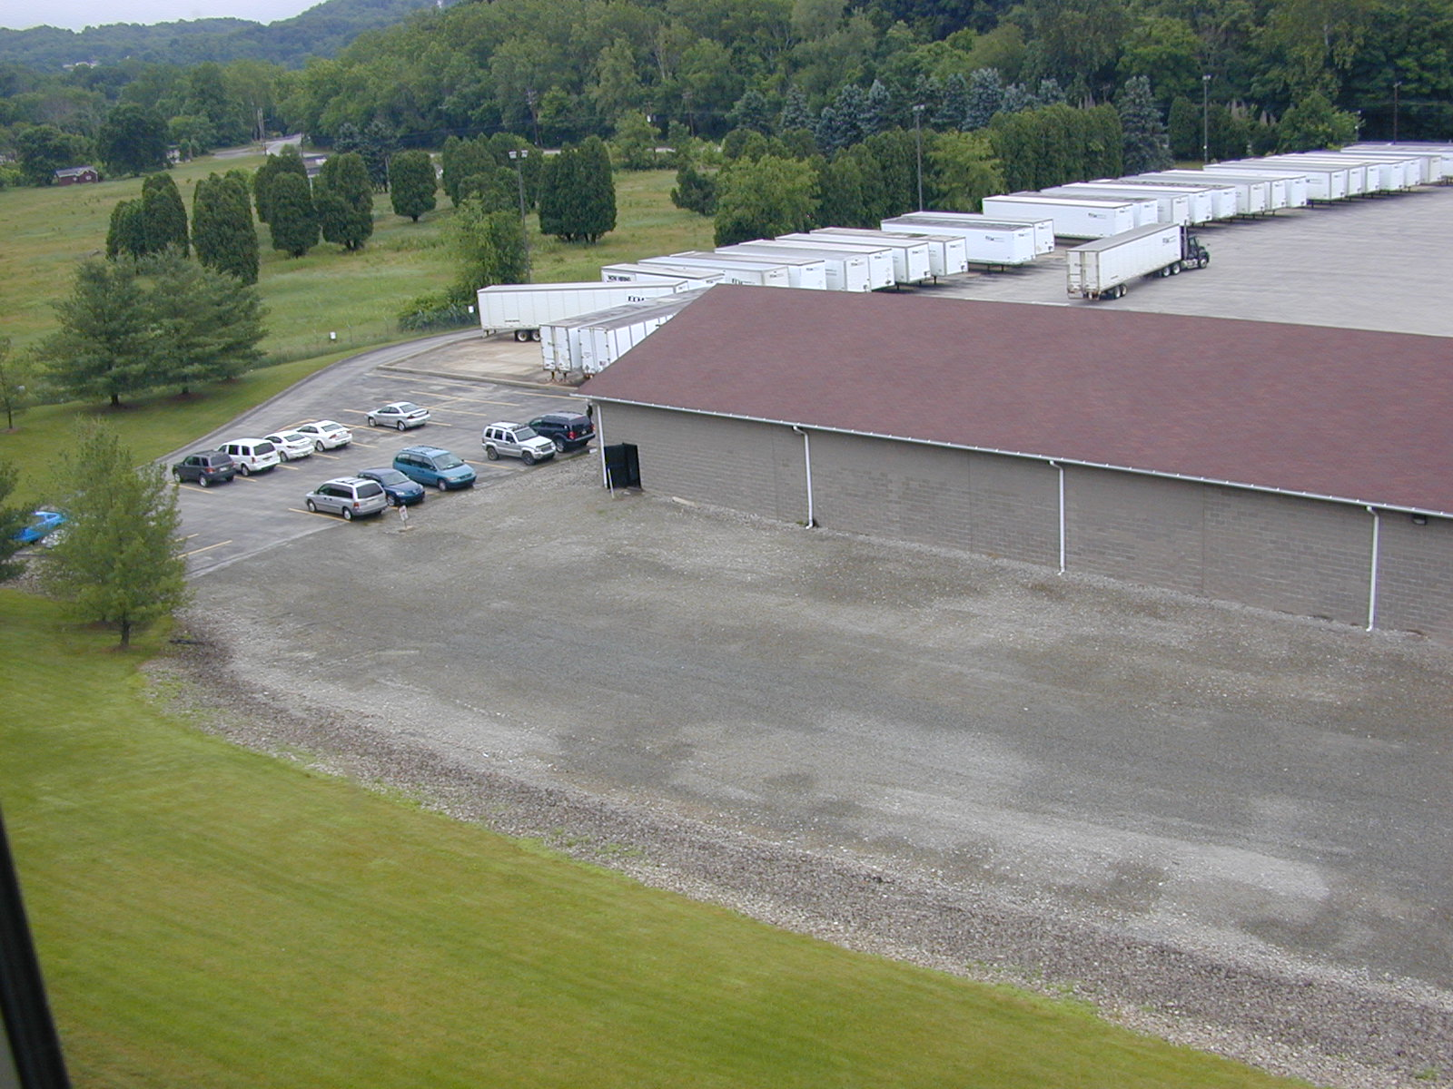
PBSD - Transportation and Maintenance Facility
Project Status Report – 1460 Greensburg Road
Plum Borough School District
Richard Zucco & Michael Brewer
June 29, 2015
Notes:
This template can be used as a starter file to give updates for project milestones.
Sections
Right-click on a slide to add sections. Sections can help to organize your slides or facilitate collaboration between multiple authors.
Notes
Use the Notes section for delivery notes or to provide additional details for the audience. View these notes in Presentation View during your presentation.
Keep in mind the font size (important for accessibility, visibility, videotaping, and online production)
Coordinated colors
Pay particular attention to the graphs, charts, and text boxes.
Consider that attendees will print in black and white or grayscale. Run a test print to make sure your colors work when printed in pure black and white and grayscale.
Graphics, tables, and graphs
Keep it simple: If possible, use consistent, non-distracting styles and colors.
Label all graphs and tables.

Slide 2
Project Overview
The Plum Borough School District purchased the property on 1460 Greensburg Road, New Kensington, PA 15068.
PBSD took physical possession of the property on Monday, April 13, 2015.
The goal of the purchase is to relocate the Transportation and Maintenance Departments.
PBSD plans to make improvements to the property to better house the Transportation and Maintenance Departments.
Notes:
What is the project about?
Define the goal of this project
Is it similar to projects in the past or is it a new effort?
Define the scope of this project
Is it an independent project or is it related to other projects?
* Note that this slide is not necessary for weekly status meetings

Slide 3
Current Status
Insurance coverage has been gained for the property. √
Exterior locks have been secured and AG Mauro has been contacted to assess the lock sets. √
The gas, water and electricity bills have been transferred to PBSD. √
The Plum Borough Police have placed the property on their surveillance watch. √
Bus radios have been tested for transmission access. √
Comcast has completed a site survey for Internet access. √
Taped video camera surveillance is being conducted until our security system can be installed. √
Bid specifications are being developed for the renovations of the property. √
Bids are being garnered for computer and Internet connectivity, routing and access. √
Contact has been made to Allied Waste Management for their services. √
Allegheny Fencing has been contacted for a site visit and assessment. √
Maintenance vehicles and buses are being parked within the facility. √
Three Rivers has been contacted to sweep the entire lot of debris. √
√ = completed
Notes:
* If any of these issues caused a schedule delay or need to be discussed further, include details in next slide.

Slide 4
Current Status (cont.)
Quote received for new lock set for the facility - $8874. √
Received a quote for fence installation and razor wire removal for $7,840. √
Pending quote for fire/security alarms. √
A roll out dumpster will be on site on May 6th for debris removal. √
Four (4) “No Trespassing – Video Surveillance” signs will be posted ($160). √
Comcast has been granted permission to begin construction on installing Internet connectivity, routing and access to the site. PO developed and approved. Cost is approximately $22,000. √
All utilities (electricity, water and gas) have been placed into the ownership of the District. Costs associated with the transfer were as follows: $3,320, $681, $546 for security deposits for Duquesne Light and $100 for MANK. √
PA DEP Storage Tank Application has been completed and submitted. √
Security and Fire Alarm quote received for the Maintenance and Transportation buildings, $2925 and $2830, respectively. √
Evaluations on septic system completed. √
Change of Occupancy Forms have been completed. √
Exterior fence has been restored. √
Internet Access work has been completed. √
                √ = completed

Slide 5
Current Status (cont.)
Comcast completed connectivity work and Internet access is available on site. √
Interior and exterior of buildings were cleaned and debris removed via rollout dumpster. √
Schematic designs will reflect the addition of data ports and bus radio wiring. √
Installation of signage, new doors and locks. √
Bid specifications awaiting completion and advertising.
Septic system will be flushed and mound will be graded, appropriately.
Researching the subdivision and combing of parcels within the new facility property.
Bus antennae and radio access has been installed at Office Building location.
Transportation Office has been moved to Office Building location.
Mechanics Building has been cleaned and painted.
Mechanics supplies/tools have been moved to the new Mechanics building.
Mechanics Building is occupied.
Project is behind schedule by 30 days and proceeding, as of July 1, 2015. √ = completed

Slide 6
Costs
Preliminary Estimates on Improvements - $275,000 - $325,000
  Terminal - Office Space, Lounge, Training Room, HVAC, Restrooms, ADA, Doors, Windows, etc.
  Garage - Heat, Replace Fixtures, Paint, Clean, etc.
  Outside - New Septic System, Glow Plugs, Bus Roof, Wash Station, etc.
Notes:
Duplicate this slide as necessary if there is more than one issue.
This and related slides can be moved to the appendix or hidden if necessary.

Slide 7
Timeline
Milestone 1
Milestone 2/3
Milestone 4/5
April 13, 2015 – Possession of Property
April 28, 2015 – Approval to Bid – Property Improvements
September, 2015 – Transportation and Facility Departments Occupy New Facility
July/August, 2015 – Construction/Renovations
Milestone 6/7
July 20, 2015 – Transportation Office Moves to Office Building
July 21, 2015 – Award Bids
August 3, 2015 – Mechanics Building Occupied
Notes:
The following slides show several examples of timelines using SmartArt graphics.
Include a timeline for the project, clearly marking milestones, important dates, and highlight where the project is now.

Slide 8
Issues and Resolutions
Issues
Resolutions
Potential delays based on the Allegheny County Health Department reviewing the septic system and the Plum Borough Council reviewing plans .
ACHD reviewed the system and recommends a thorough ‘clean out’ of the system and few additional layers of topsoil to the mound. Issue resolved; delays not expected. Current delays in Plum Borough Council review.

Slide 9
Dependencies and Resources
Project
Moving
Construction
Bids
Technology/
Connectivity
Notes:
What are the dependencies that affect the timeline, cost, and output of this project?

Slide 10
Appendix
Budget to Date
  Tentatively – $275,000 – $325,000
Design Documents
  Terminal Schematic of Improvements – Refer to Next Slide
Supplemental Documents
  Terminal Schematic and Photos
Contact information
  Michael Brewer – PBSD – Director of Administrative Services (412)-798-6370
  Rich Zucco – PBSD – Board Chair – Facilities (412)-303-3394
  Bob Holleran – PBSD – Facilities Director (412)-798-6366
  Denny Russo – Construction Manager (412)-215-3023

Slide 11
Terminal Schematic of Improvements

Slide 12
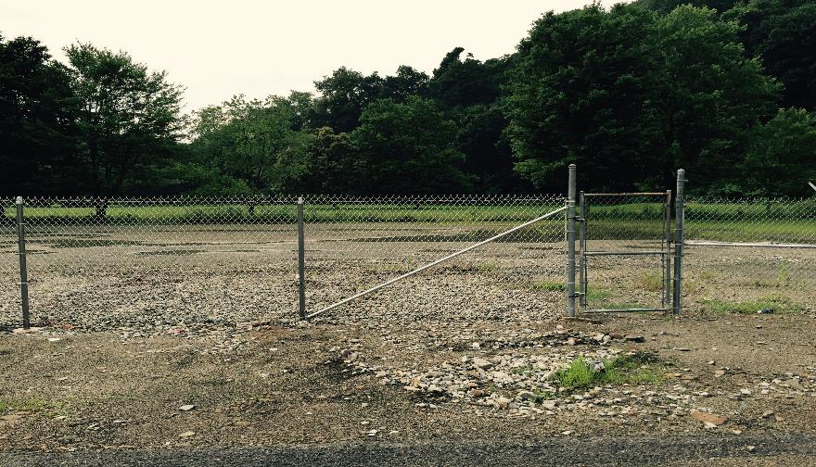
Facility Upgrade – New Fencing

Slide 13
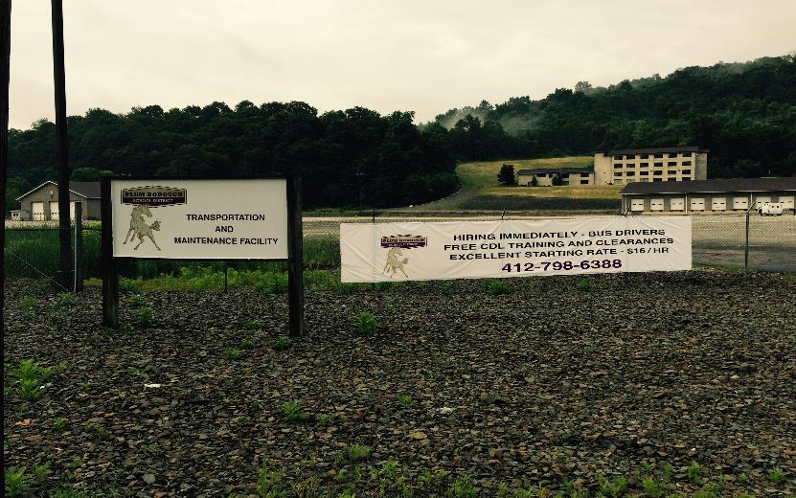
Facility Upgrade – New Signage and Advertisement Banner

